Slide 1
E-HEALTH Seamless Doctor Appointments for Modern Healthcare

Slide 2
TABLE OF CONTENTS
01
02
03
04
05
06
BACKGROUND INFORMATION
ABSTRACT
OBJECTIVES
SCOPE
USE CASE SPECIFICATION
USE CASE & SEQUENCE DIAGRAM

Slide 3
ABSTRACT
The Online Doctor Appointment System simplifies scheduling and managing doctor appointments. Patients can easily book, view availability, and receive reminders, while doctors and administrators manage user information, medical records, and appointments. This digital solution enhances patient satisfaction and streamlines healthcare services, reducing the complexities of traditional scheduling.

Slide 4
BACKGROUND INFORMATION
Traditional appointment booking is often inefficient, leading to missed appointments and delays. Online doctor appointment systems streamline scheduling, improve time management for healthcare providers, and offer patients a convenient way to book appointments from home.

Slide 5

OBJECTIVES
Improved Accessibility
Streamline Appointment Booking
Enhance Patient Privacy
Efficient Waiting List Management
Fast and User-Friendly Experience
Ensure Access to Verified, trustworthy Doctors

Slide 6
SCOPE
The Online Doctor Appointment System provides core features for efficient appointment scheduling, secure patient record management, and streamlined communication. It includes easy booking and cancellation, role-based data access for privacy, automated reminders, and a feedback system to improve service quality.

Slide 7
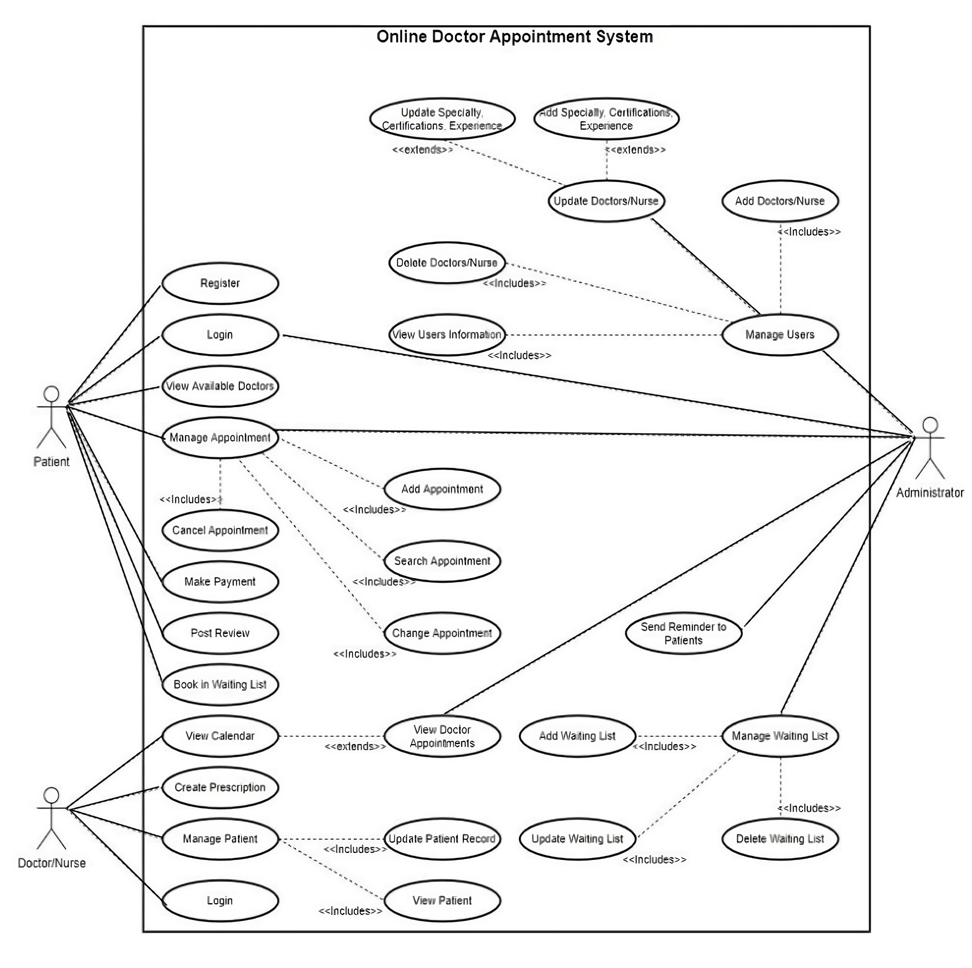
USE CASE DIAGRAM

Slide 8
Use case name | UC1: User Login and Account Creation
Actor(s) | User, System Authentication
Description | A user creates a new account on the system. It has successful login, invalid credentials, and account creation.
Reference ID
Typical Course of events | Actor action Step 1: The user selects the "Sign Up" option and enters personal details (name, email, age, password, confirm password). Step 3: The user clicks on the "Submit" button to proceed with account creation. Step 5: The user enters their email and password to log in. | System response Step 2: The system verifies the entered details (name, email, age, password, confirm password). Step 4: If the details are valid, the system creates a new account and saves the credentials in the database. It displays a success message. Step 6: The system validates the credentials with the database. Step 7: If the credentials are correct, the system grants access to the user and redirects them to their profile.
User Login and Account Creation

Slide 9
The alternative course of events | Step 2.B: If missing or invalid information is detected (e.g., email format, password length), the user corrects the fields. Step 4.A: If the login fails due to incorrect email or password, the user is notified. Step 5.A: If the system is under maintenance, the user is notified. | Step 2.C: The system highlights the invalid or missing fields for correction. Step 4.B: The system displays an "Invalid email or password" message. Step 5.B: The system displays a "Temporarily unavailable" message. displays a "temporarily unavailable" message
Precondition | The user must have accurate information ready for sign-up, such as name, email, age, and password (including confirmation). | The system must be operational, capable of validating and storing credentials securely.
User Login and Account Creation

Slide 10
Use case name | UC2: Doctor Registration and Approval
Actor(s) | Doctor, Admin, System
Description | Doctors sign up and await admin verification before gaining access to patient appointments
Reference ID
Typical Couse of events | Actor action Step 1: Doctor registers by providing the following details: name, email, password, confirm password, contact number, specialization, consultant fee, available days, registration number, start check-up time, and end check-up time. Step 3: Doctor uploads a profile picture (optional) and updates their profile if needed. Step 5: Admin reviews the doctor’s details and credentials. Step 7: The doctor logs in with their approved account. | System response Step 2: The system notifies the admin of a pending doctor registration.Step 4: The system stores the updated profile and profile picture. If the doctor’s account is pending approval, the system displays the message: "Your account is pending approval. Patient services will resume after verification. Please wait for verification or contact admin after 24 hours. Thank you for your patience."Step 6: The system approves the registration and sends an approval confirmation to the doctor.Step 8: The system validates credentials and grants access to the doctor interface
An alternative course of events | Step 2.A: The doctor provides additional registration details if prompted. Step 4.A: The admin reviews the doctor's information and chooses to deny approval if the requirements aren’t met. | Step 2.B: The system detects insufficient registration information and prompts the doctor to complete any missing fields. Step 4.B: The system notifies the doctor of the denial and provides feedback on what is missing or incorrect.
Precondition | The system must notify the admin of pending doctor registrations. | The system reflects the doctor’s access status and grants access to the doctor interface after verification.
Doctor Approval and Verification

Slide 11
Use case name | UC3 - Admin Panel and Permissions
Actor(s) | Actor(s): Admin, System
Description | Admin manages the permissions of patients and doctors, reviews appointments, and oversees the platform's functionality.
Typical Course of events | Actor action Step 1: Admin logs into the control panel Step 3: Admin views the dashboard, which includes details about doctors, patients, and appointments. Step 5: Admin approves or denies doctor applications or modifies appointments if necessary. Step 7: Super Admin decides to add a new admin. Step 9: Admin confirms the addition of a new admin or approves doctor registration. | System response Step 2: The system validates credentials and grants admin-level access. Step 4: The system displays the requested data in a manageable interface, showing doctor details, patient details, and appointment information. Step 6: The system updates records changes. Step 8: The system prompts the super admin to enter the new admin's details and sets permissions. Step 10: The system grants the new admin access or approves the doctor registration and notifies the relevant users.
Alternative course of events | Step 1.A: Admin enters an invalid email or password while logging into the control panel. Step 3.A: Admin attempts to add a new admin with invalid credentials or missing details | Step 2.A: The system displays an "Invalid email or password" message and prompts the admin to re-enter valid credentials. Step 4.A: The system displays an error message, asking the admin to enter valid details and reauthorize the action.
Precondition | The admin sees the updated user permissions, doctor registrations, and appointment details after successful approval | The system must be fully functional and accessible for performing administrative tasks.
Admin Control Panel and Permissions Management

Slide 12
Use case name | UC4 - Schedule Appointments
Actor(s) | Patient, System
Description | Patients schedule, view, or cancel appointments, search for doctors, and complete payments.
Typical Course of events | Actor action Step 1: The patient selects a doctor from the list of available doctors based on specialization, available days, and times. Step 3: The patient reviews the doctor's available days and times. Step 5: The patient selects an available date and time for the appointment. Step 7: The patient views scheduled appointments and summaries of past appointments. | System response Step 2: The system displays the doctor's available schedule, including available days and times. Step 4: The system provides detailed information about the doctor, including specialization and available dates and times. Step 6: The system checks the doctor's availability for the selected date and time. If available, the system confirms the appointment. Step 8: The system displays the scheduled appointment details and past appointment summaries.
Schedule Appointments

Slide 13
Alternative course of events | Step 1.A: If there are no available doctors, the patient is notified that no doctors are currently available. Step 3.A: If the patient selects a time or date that does not match the doctor's availability (based on the schedule displayed), the system notifies the patient that the doctor is unavailable for the selected date and time. | Step 2.A: The system displays a message indicating that no available doctors are present for selection. Step 4.A: The system displays a message indicating that the doctor is not available for the selected date.
Precondition | The doctor must be available for appointments. | The system must be able to check doctor availability in real time.
Schedule Appointments

Slide 14
Use case name | UC5 - Patient can Search by Specialization
Actor(s) | Patient, System
Description | Patients search for doctors based on specialization.
Typical Course of events | Actor action Step 1: The patient enters the desired specialization in the search bar. Step 3: The patient clicks "Search" to submit the request. | System response Step 2: The system searches the database for doctors with the matching specialization. Step 4: If matching doctors are found, the system displays a list of available doctors with their details (e.g., name, specialization, availability) Step 5: If no matching doctors are found, the system will show nothing in the available doctors
Alternative course of events | Step 3.A: The patient attempts to search without entering a specialization. | Step 3.B: The system will show the all available doctors.
Precondition | The patient must have access to the system and be able to search for doctors based on specialization. | The system must have data on doctors’ specializations for search functionality to work.
Search Doctors

Slide 15
SEQUENCE DIAGRAM

Slide 16
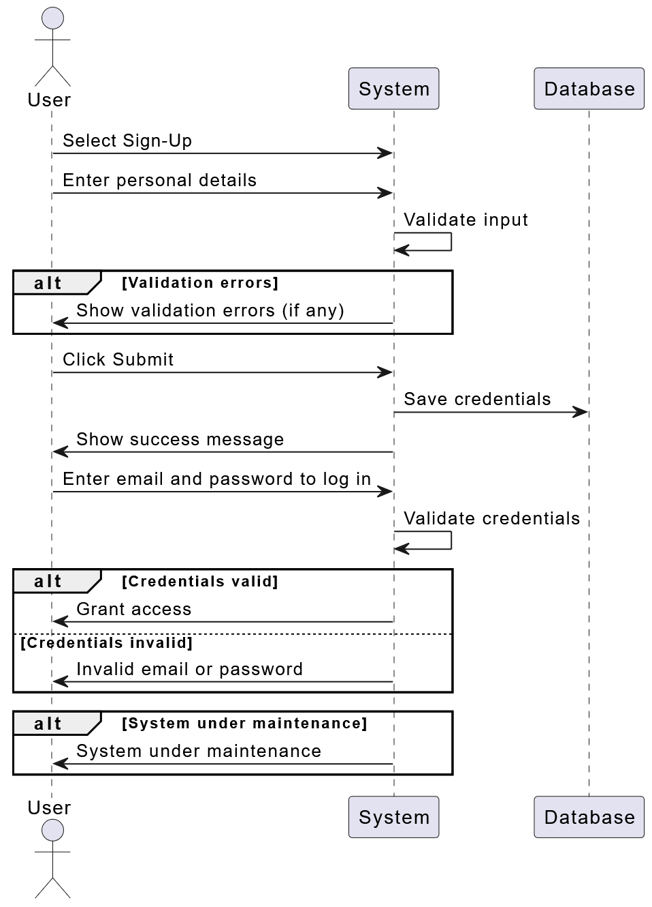
User Login & Account Creation

Slide 17
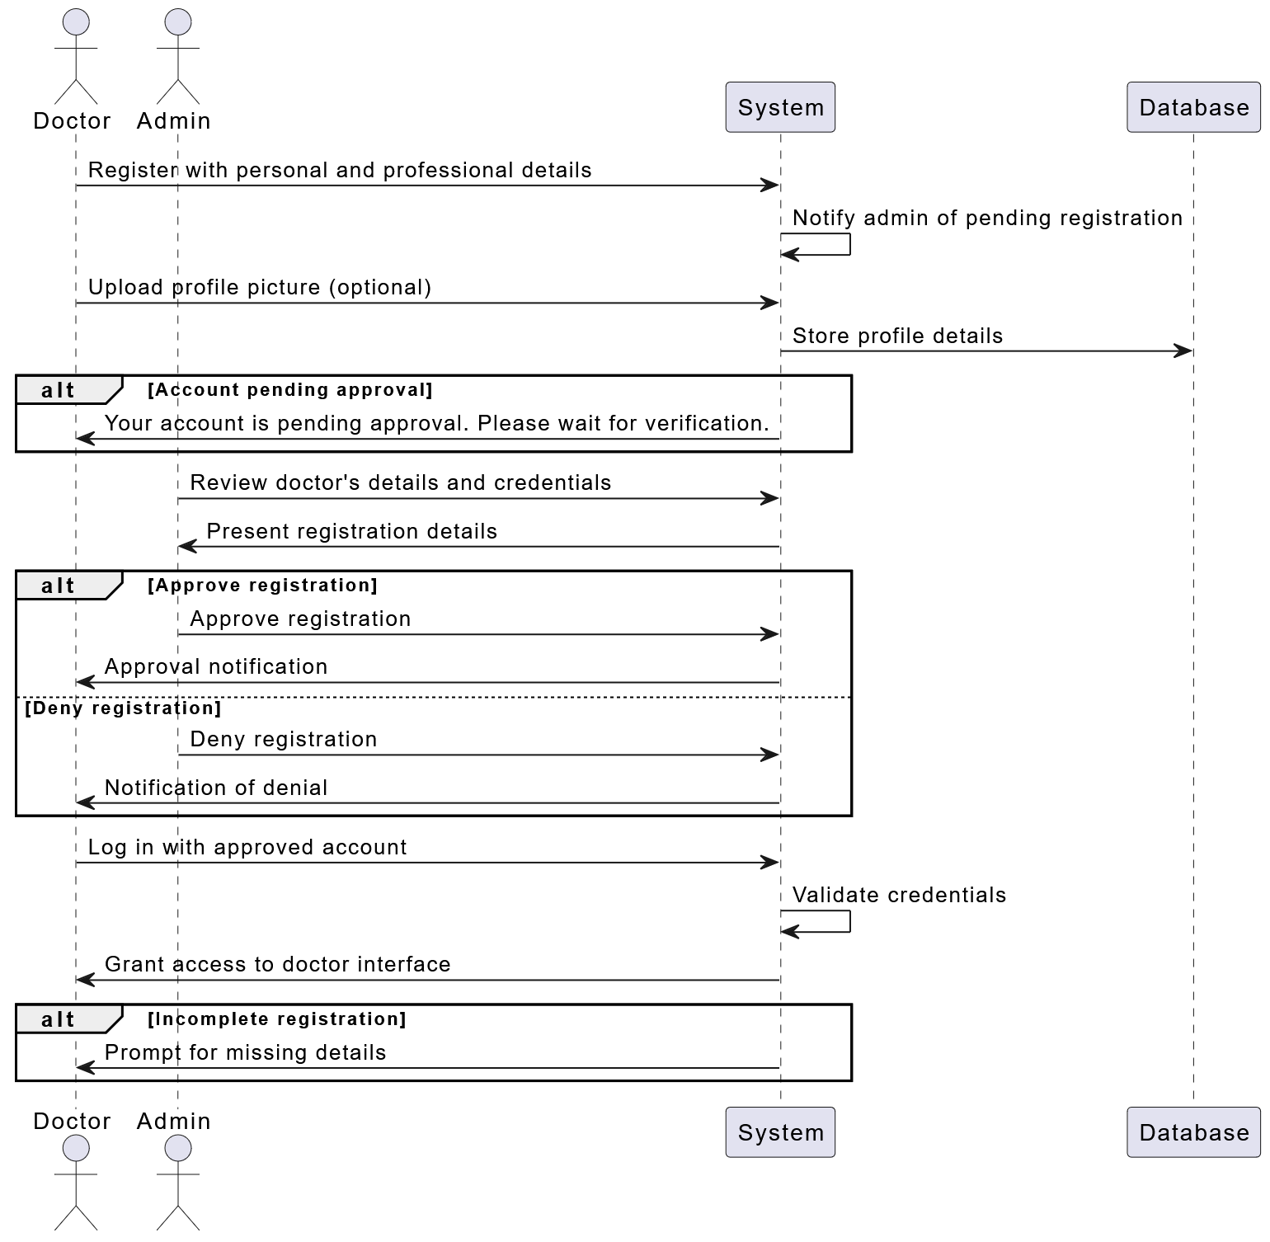
Doctor Approval & Verification

Slide 18
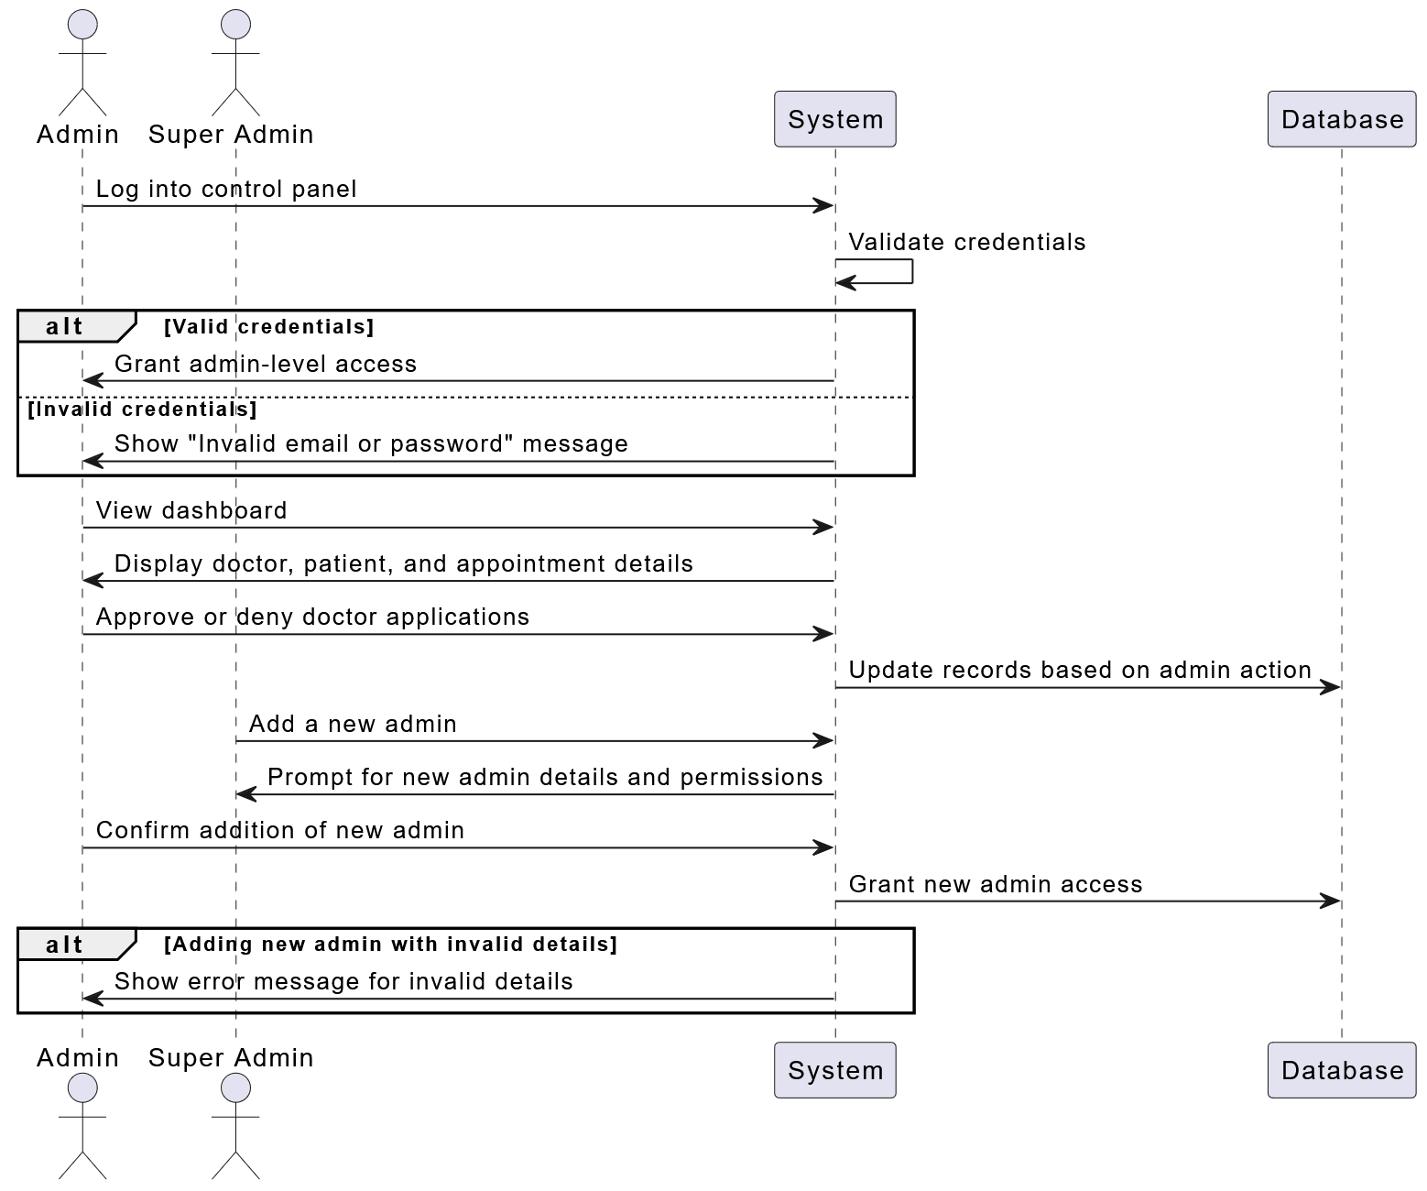
Admin Control Panel & Permissions Management

Slide 19
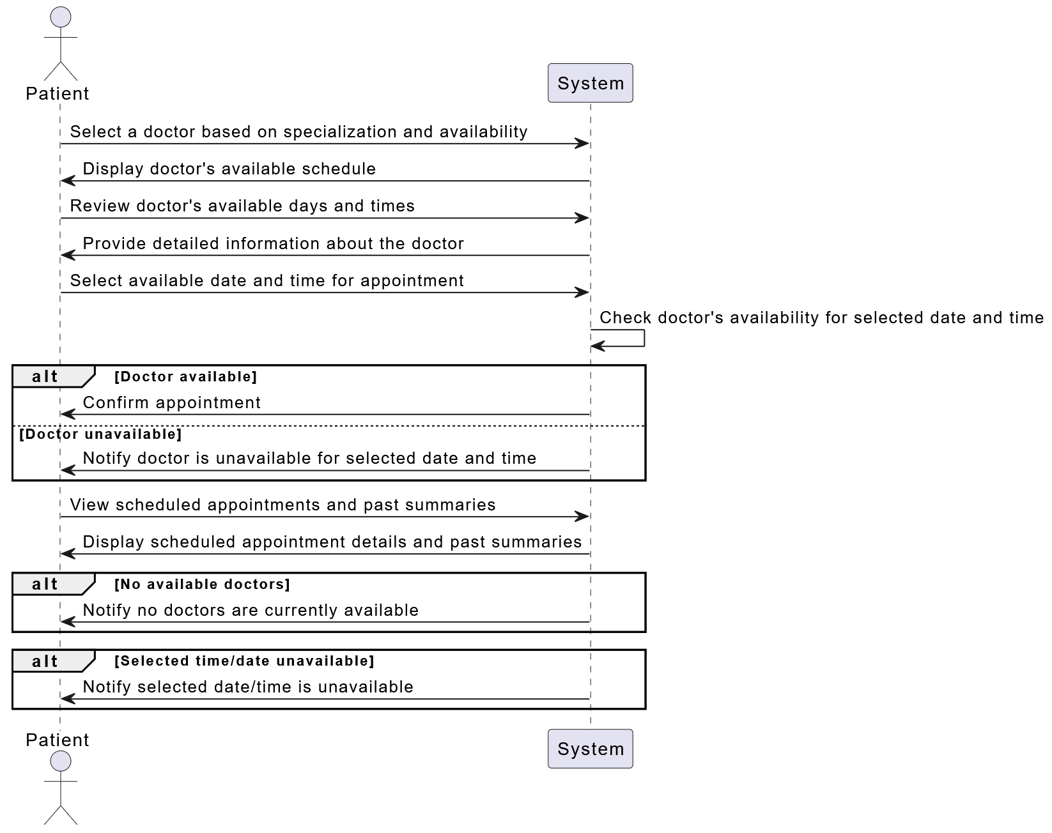
Schedule Appointments

Slide 20
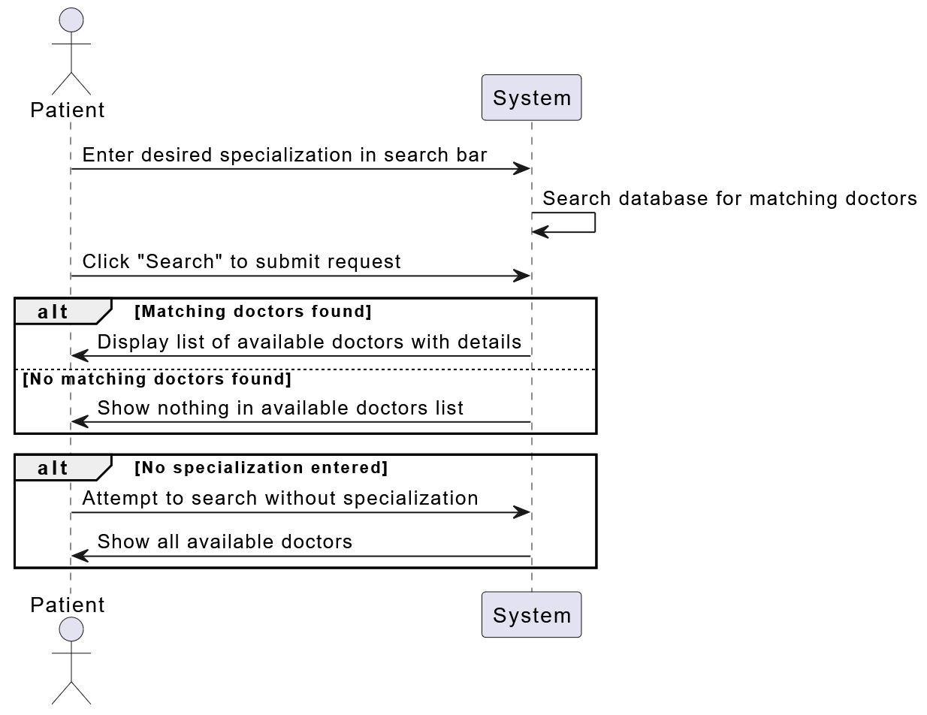
Search Doctors

Slide 21
OUR TEAM
Md .Shahariear Hossen Rabo
Id : 221-15-5164
SEC : RE_A
DEPT.OF CSE
Tamjid Mahmud Mahin
Sourav kumar Mondal
ID: 203-15-14498 SEC: RE_A DEPT. OF CSE
ID: 192-15-13235 SEC: RE_A DEPT. OF CSE

Slide 22
THANKS!

